Slide 1

Losing Customers?
By Collin Loo

Slide 2

Why Should We Care?
Studies show it is more expensive to acquire new customers than to retain existing ones. In general, it cost 5 to 7 times more to acquire new customers.
Cross products sales consideration. Studies show it is easier to sell cross products to existing customers than to new subscribers.
Losing customers hinders growth and represents lost investments.

Slide 3

Our Objectives
Use Machine Learning (ML) to identify the features that contribute to customer churn.
Present to the Customer Service, Marketing and Sales departments.
Make recommendations.

Slide 4
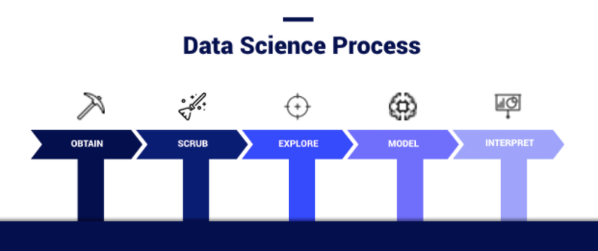
The OSEMN Framework
The OSEMN framework provides high level guidance on handling a data science project.
Following the processes outlined by OSEMN allows for efficient data modeling.

Slide 5
The OSEMN Framework
Data come from within the company.
In the Scrub process:
Examine columns to determine if they are text or numbers?
Remove columns that do not contribute values to our ML model, such as phone numbers.
Handle missing values in columns, if any.
Obtain and Scrub Process

Slide 6
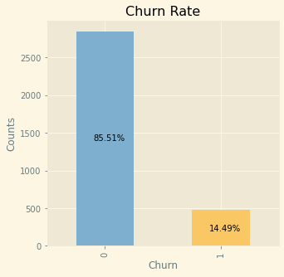
The OSEMN Framework
Explore Process
There are 3,333 records in the dataset.
The oldest account in the dataset is 8 months old. The average account age is 3.5 months.
The dataset is composed of mainly new customers.
We’ve lost 14.49% or 500 fairly new customers.

Slide 7
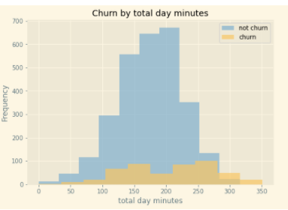
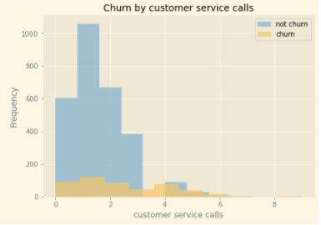
The OSEMN Framework
Explore Process
Customers with heavy daily usage are more likely to leave than customers with less total daily usage .
We tend to lose customers when they make a high number of calls to our customer service lines.

Slide 8
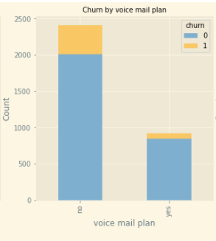
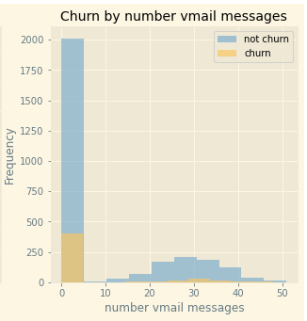
The OSEMN Framework
Explore Process
Voice mail plan plays an important role in deciding whether customers will stay or leave. Customers without a voice mail plan leave more often than those that have a voice mail plan.
For customers with a voice mail plan, the more voice messages they have, the higher the risk they will leave.

Slide 9

The OSEMN Framework
Classification Algorithms
In predicting customer Churn, we are basically predicting a Yes or No outcome. In data science, this is commonly known as a classification problem.
There are several methods at our disposal to address this issue. We will evaluate four algorithms at this stage, namely Logistic Regression, K-Nearest Neighbors, Random Forest and XGBoost.
The method that can predict more true positives and less false negatives will be our final model.
Model Process

Slide 10
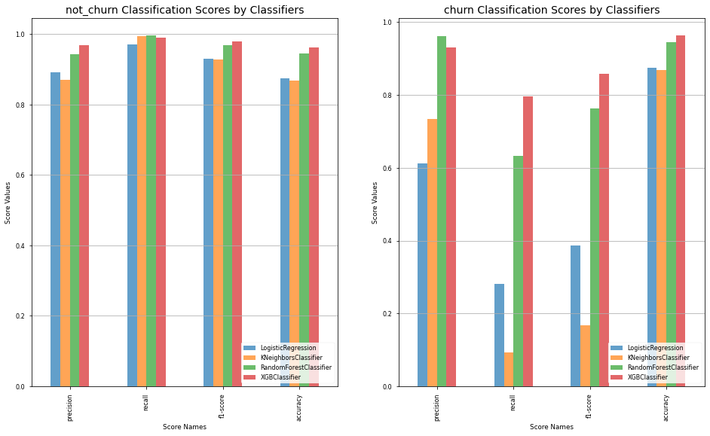
The OSEMN Framework
Model Process – Baseline
To judge how well a model performs, one approach is to look at the various scores it produces, such as the precision score, the recall score, the F1_score and the accuracy score.
As our objective is to maximize model prediction for true positives and minimize false negatives, this information is captured in the recall score.
The XGBoost algorithm delivers the highest recall scores in predicting both the ‘Churn’ and ‘Not Churn’ labels.

Slide 11
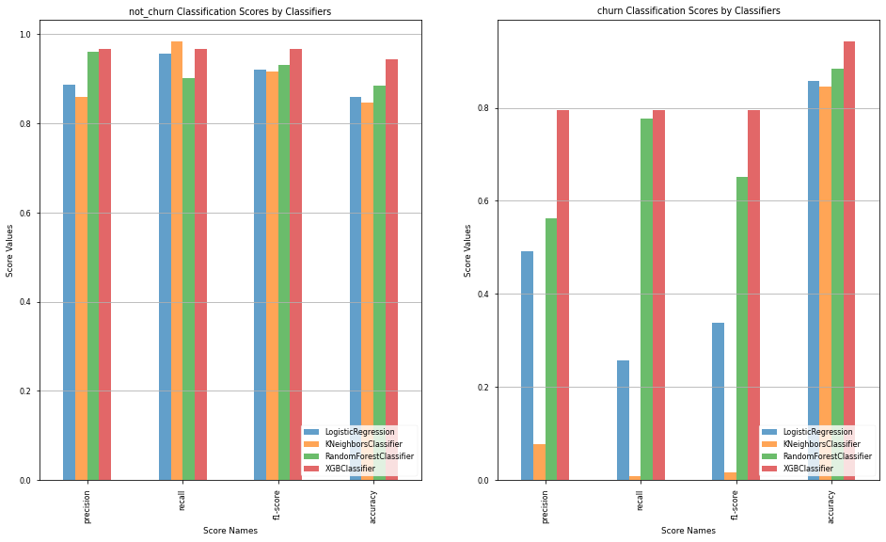
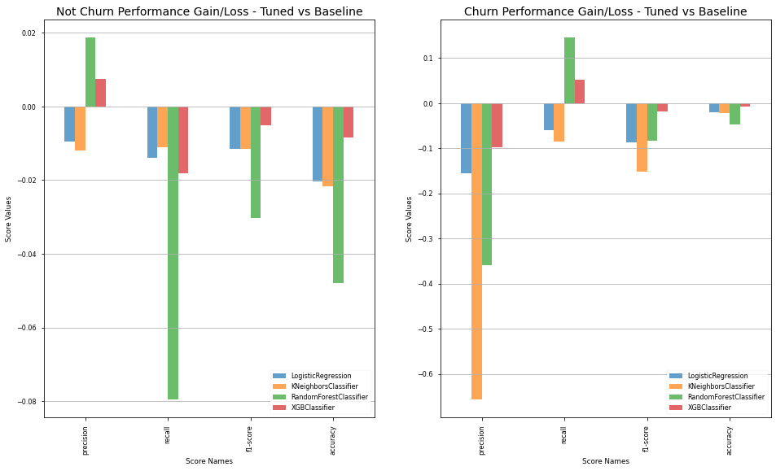
The OSEMN Framework
Model Process – Tuning
Due to the fact that the data contains less number of customers leaving, this can cause an issue in our model. We address this by resampling our data.
The models themselves come with various parameters for fine tuning. We ran our models through different combinations of parameters to find the best one.
XGBoost method outperformed the other three methods in most scoring. It will be our model of choice.

Slide 12
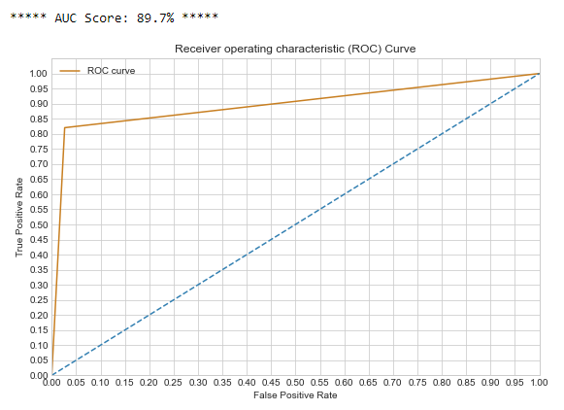
The OSEMN Framework
Model Process – Evaluation
A useful model not only works well on controlled data but also need to perform equally well for unseen data.
Our final model yields a 99.92 accuracy score on controlled data and 95.2 accuracy score on unseen data. Therefore, it will work well with new data in the future.
The AUC score is another measure for model performance. Our model has an AUC score of 89.7% which means it has a probability of 89.7% chance of correctly distinguishing between the ‘Churn’ and ‘Not Churn’ labels.

Slide 13
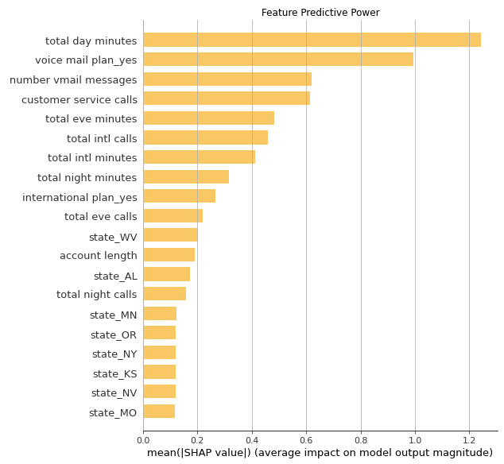
The OSEMN Framework
Model Interpretation
We utilize a SHAP package to help us explain our model.
The feature that impacts our model prediction for Churn the most is ‘total day minutes’.
‘Voice mail plan_yes’ comes in second, followed by ‘number vmail messages’ and ‘customer service calls’.
‘Total day minutes’ has twice the influence over the model outcomes than ‘customer service calls’.

Slide 14
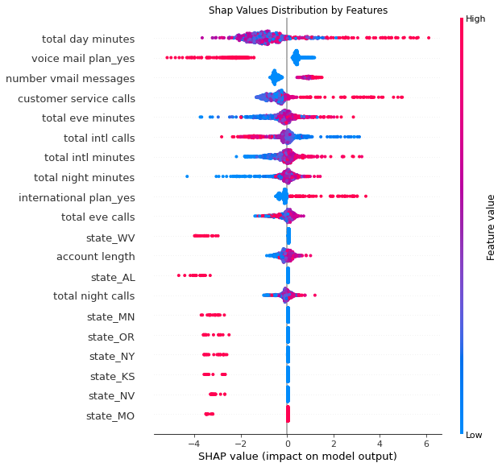
The OSEMN Framework
Model Interpretation
This plot explains how an individual customer with a given feature contributes to the model outcome.
Customers without a voice mail plan or with low voice mail messages (blue dots) have a tendency to leave.
In the case of number of call to service lines, the more frequent a customer contacts our service lines, the more likely he/she will leave.

Slide 15

Recommendations
We will use the top four most influential features to make recommendations on how to stop customer churn.

Slide 16
Issue
Customer with heavy daily usage are most likely to leave.
Proposal
Micro segment day time minutes rate. Review current day time rate structures to see if additional rate levels make sense.
‘Frequent-flyers’ approach. Create VIP class for heavy usage users and reward them with benefits.
Recommendations
Total Day Minutes

Slide 17
Issue
Customers without a voice mail plan are most likely to leave.
Proposal
Undertake comparative analysis to see what our competitors are doing.
Match or beat their offerings.
Recommendations
Voice Mail Plan - Yes

Slide 18
Issue
Customers with more voice mail messages are most likely to leave.
Proposal
Review limitations and restrictions on voice mail storage.
Understand what competitors are offering.
Analyze infrastructure capacity to anticipate future offerings.
Recommendations
Number of Voice Mail Messages

Slide 19
Issue
Customers with more calls to the service line are most likely to leave.
Proposal
Review nature of the calls.
Conduct customer satisfaction surveys.
Evaluate performance of customer service agents.
Recommendations
Number of Customer Service Calls

Slide 20

Future Work
Include other algorithms like Bayesian Classification and Support Vector Machines in our model.
Employ different data sampling techniques.
Introduce additional algorithm tuning parameters.

Slide 21




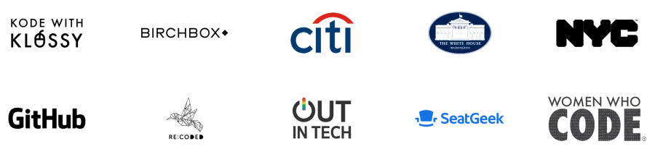

Thank You
Change things
At Flatiron School you learn how the future is being built, so you can change anything, starting with a new career in code, data science, or cybersecurity.
Collin Loo
collinloo@yahoo.com
Flatiron School

